Slide 1

Austin Transportation Department Signs Work Orders
Created By: Susanne Gov Created Date: 2020-08-10 Location Name: 7TH ST / PLEASANT VALLEY RD Intersection ID: 5161138 Cardinal Direction: N Work Order ID: SG-20355
Sign Type | Install/Remove
Left Turn Arrow Only | Install
Left Turn Yield Flashing Yellow | Remove
Street Name Sign | Install
Straight Right Arrow | Install

Slide 2
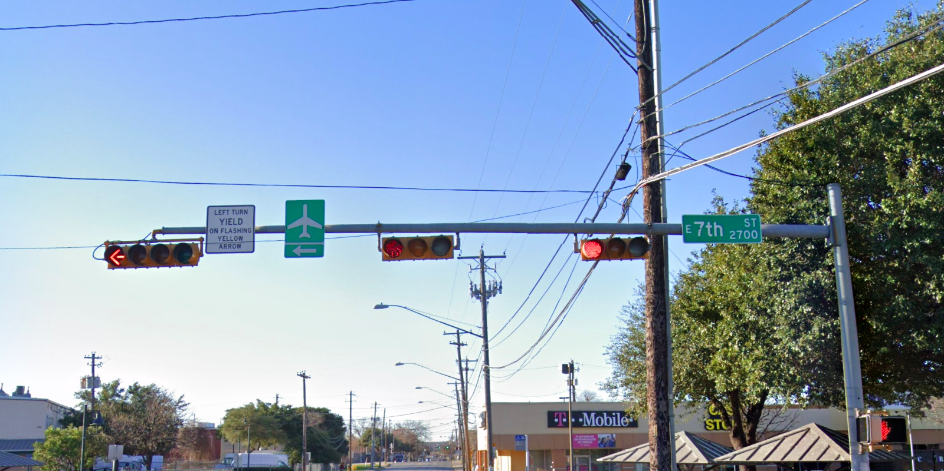
Austin Transportation Department Signs Work Orders
Created By: Susanne Gov Created Date: 2020-08-10 Location Name: 7TH ST / PLEASANT VALLEY RD Intersection ID: 5161138 Cardinal Direction: S Work Order ID: SG-20355
Sign Type | Install/Remove
Left Turn Yield Flashing Yellow | Remove
Airport Symbol | Install
Street Name Sign | Install

Slide 3
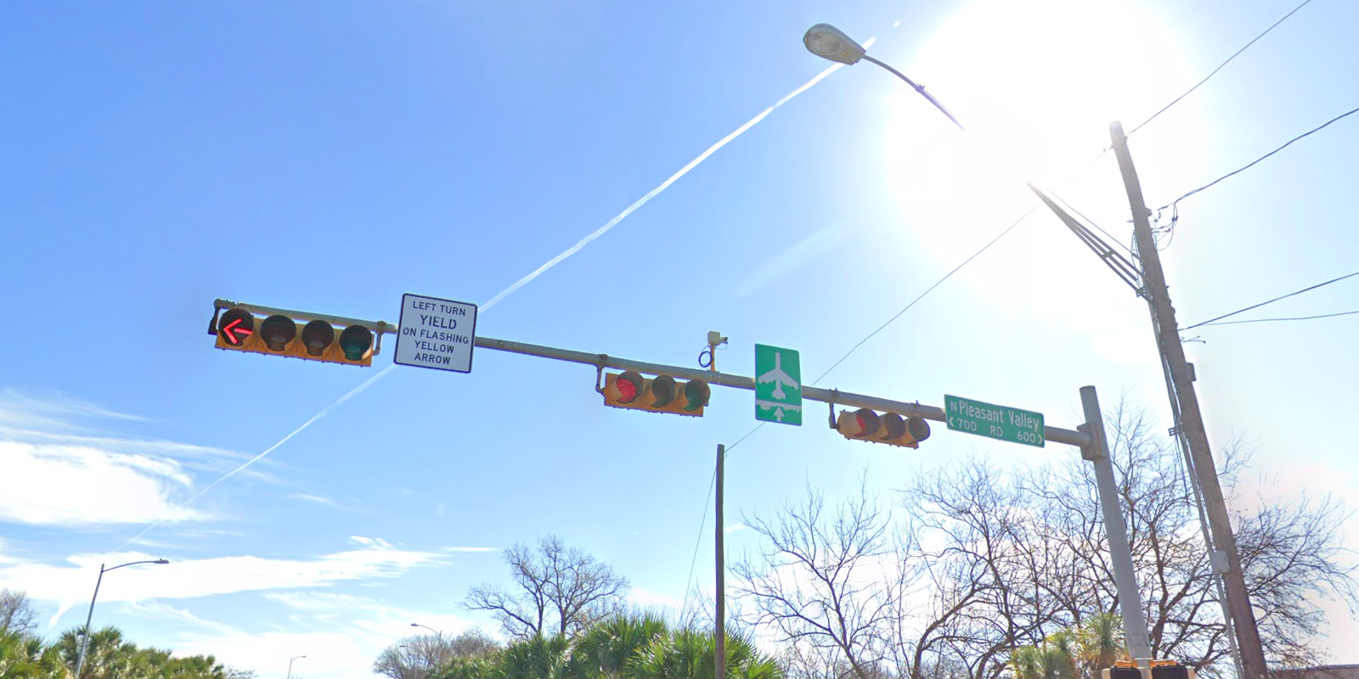
Austin Transportation Department Signs Work Orders
Created By: Susanne Gov Created Date: 2020-08-10 Location Name: 7TH ST / PLEASANT VALLEY RD Intersection ID: 5161138 Cardinal Direction: E Work Order ID: SG-20355
Sign Type | Install/Remove
Left Turn Yield Flashing Yellow | Remove
Street Name Sign | Install
Airport Symbol | Install

Slide 4
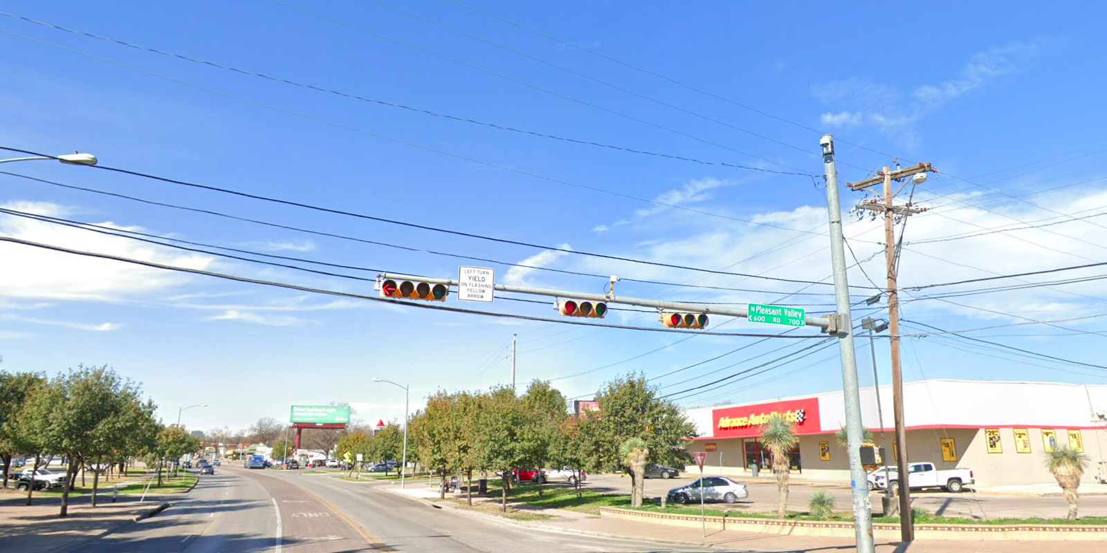
Austin Transportation Department Signs Work Orders
Created By: Susanne Gov Created Date: 2020-08-10 Location Name: 7TH ST / PLEASANT VALLEY RD Intersection ID: 5161138 Cardinal Direction: W Work Order ID: SG-20355
Sign Type | Install/Remove
Left Turn Yield Flashing Yellow | Remove
Street Name Sign | Install

